Slide 1
App interface
Application Pictures
Approvals Copies
Product data
Create a submittal

Slide 2
1- Application Pictures
Sales man to be able to take a pictures and store it in the App with the following data and conditions
Chose Type of Application picture from the following
Civil constructions
MEP
Steel and metal
Interior finish
Façade
Fire stop
Name the Application (any name )
Project Name
Type of the project from the following
Buildings
Airport , Commercial Buildings , Educational Facilities ,Hospital ,Hotel, Industrial Park , Mixed Use , Other – Buildings , Shopping Centre , Sports Facilities
Industrial
District Cooling Plants, Factories , Warehouse & Workshop
Infrastructure
Rail , Roads & Bridges , Sewage & Waste Treatment Plant , Utility ,Marine, Power & Water
Oil & Gas

Slide 3
Consultant Name (from our list or New consultant) – Possibility to added more than 1 consultant
Contractor Name (from our list or New Contractor) – Possibility to added more than 1 Contractor
Client Name
Location (Manual or by GPS).
Products used (can be more than a product )
Notes
1- the software should allow the sales man to added some the data and safe it as a draft then when he finalize all the required fields he can send it for approval
2- after picture goes for approval then the authorized person for approval he can edit the information and safe it
3- once its save it can be shared with others
For Points C, E , F , G (Possibility to added full name and short name )

Slide 4
Example of Application pictures

Slide 5
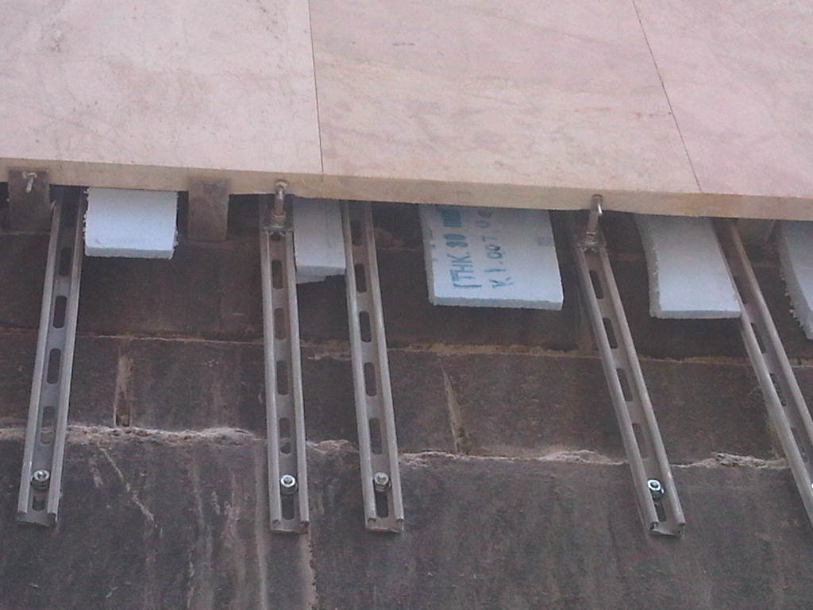
Stone Cladding
DESCRIPTION: Stone Cladding
PROJECT: Al Farwaneya School - Kuwait
PRODUCT: ACT, FAZII, FBN II, FIS V, FISP, SXR, MS Channel System, N Hammer fix

Slide 6
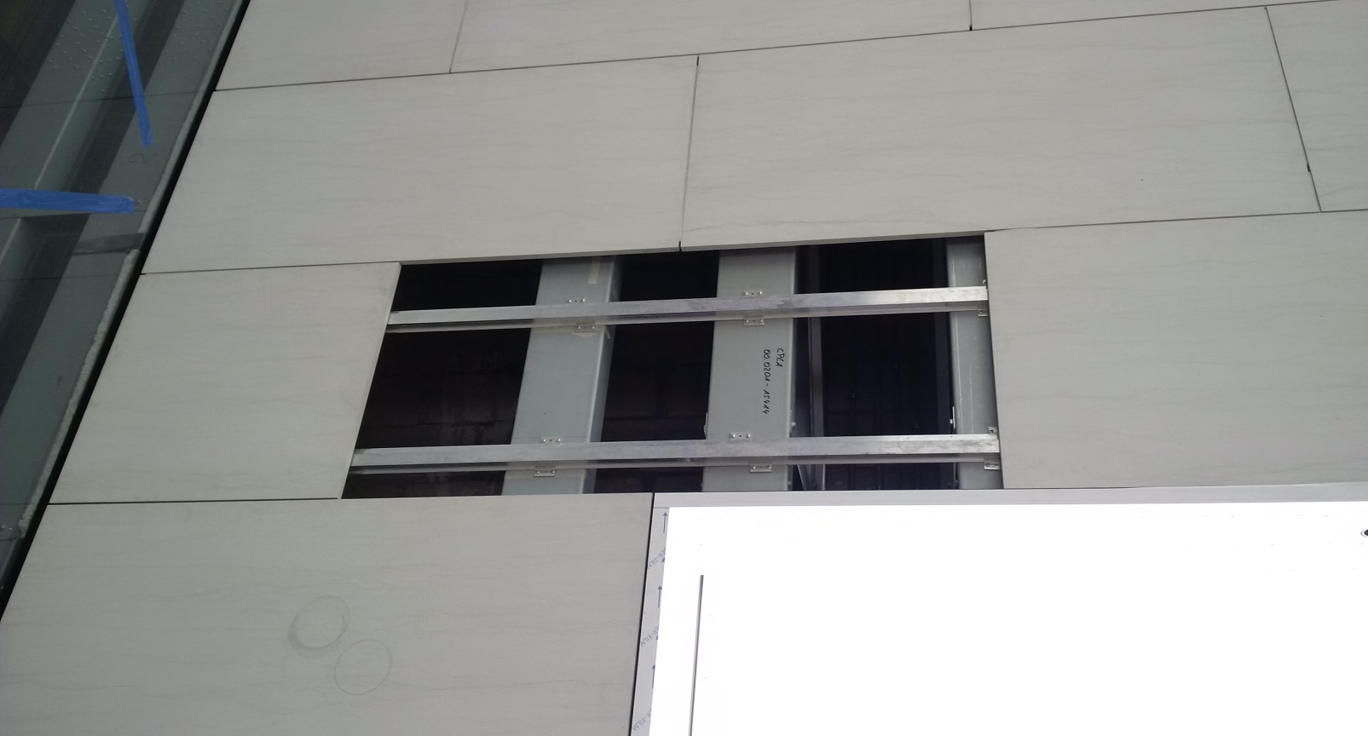
Stone Cladding
DESCRIPTION: Stone Cladding
PROJECT: Apple Showroom – YAS MALL
PRODUCT: ACT, FAZII, FBN II, FIS V, FIS P, SXR, MS Channel System, N Hammer fix

Slide 7
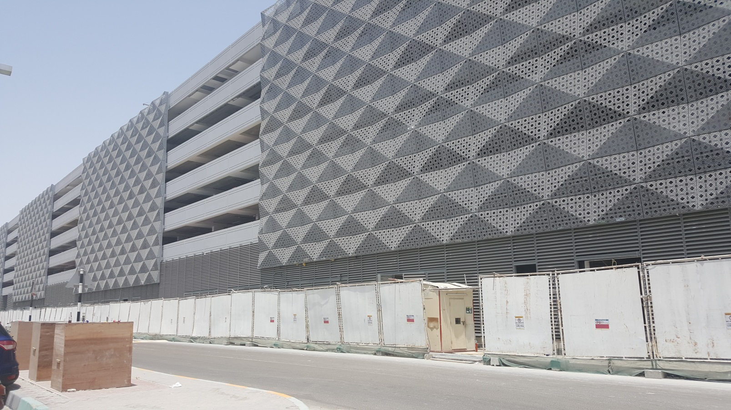
Glass & Metal Cladding (CW)
DESCRIPTION: Decorative metal façade sun shade, Louver.
PROJECT:
PRODUCT: FAZ II, FBN II, FIS V, FIS VT, FIS P, RGM, SXR, FHII

Slide 8
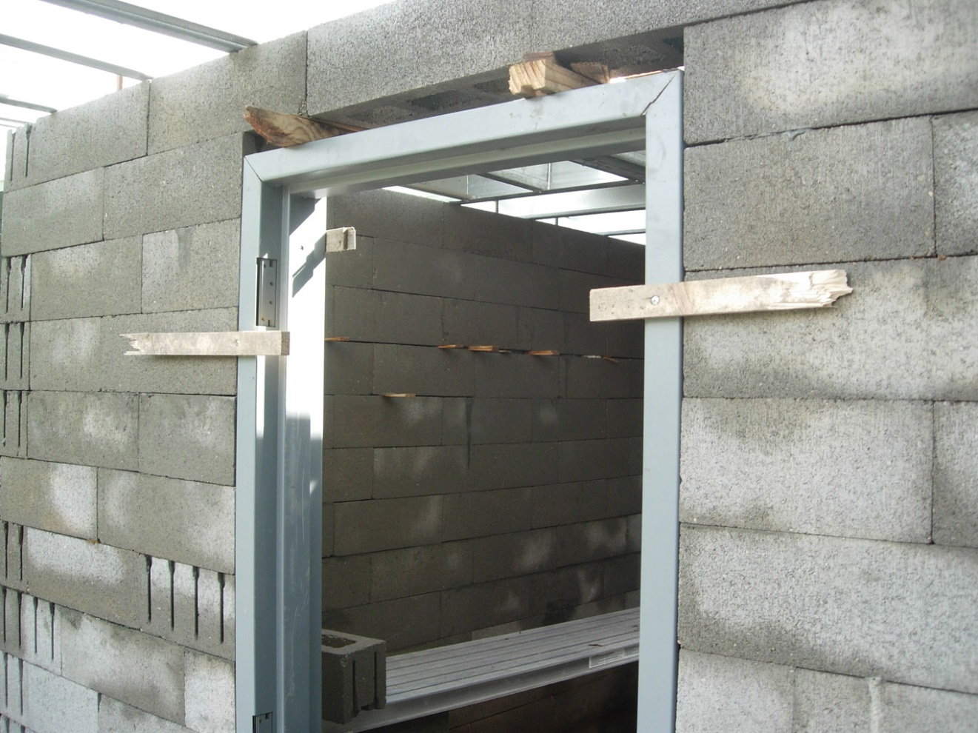
Door Frames Fixings
DESCRIPTION: Door fixing
PROJECT:
PRODUCT: SXR, Hammerfix, FM Anchor, Foam, Firestop

Slide 9
2-Approval Copies
We can scan the approval copies and inter it to the system with the following information
1- can easy import and export to Excel similar to the list above .
2- All the data in Red required to be entered with each approval copy
3- we can easy recall all the approval for a particular application or consultant for example
Next Slide example of approval Copy
SR NO | COUNTRY | NAME OF PROJECT | CONTRACTOR | SUB CONTRACTOR - IF ANY | CONSULTANT | PRODUCT | DATE OF APPROVAL | APPLICATION
327 | Kuwait | Sheikh Jaber Al Ahmad Cultural Centre | Al Hani Construction and Trading Co | Drake&Scull | Amri Diwan | Drop in Anchor, Nut, Washer, Gi Angle,Threaded Rods | 05/08/2014 | MEP

Slide 10
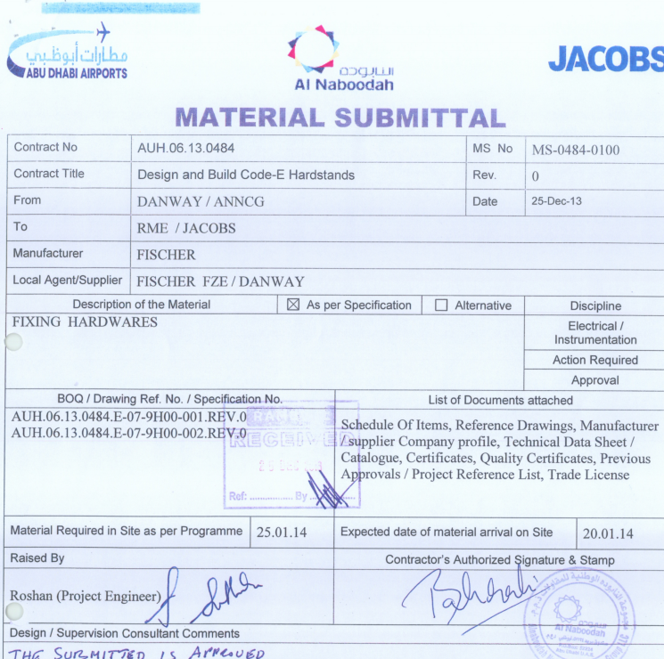

Slide 11
3-Prodcut data
Easy to enter to the system and recall the Product data sheet with the following concept
Product name
Product Article No
Catalogue page
Loading tables
International approvals
Test reports
Country of Origin

Slide 12
4- Create a submittal
Can be a product submittal or a general company submittal (PDF format)
Product Submittal (Can be for single product for group of products )
Covering page information
Chose what to include in the submittal from the following
Company Profile
Schedule of proposed material (Done external)
Catalogue page
Loading tables
International approvals
Test reports
Compliance Statement (Done external)
Calculation (Done external)
Estidama (Done external)
Country of Origin
Previous Approvals
Project References

Slide 13
Product Submittal (Can be for single product for group of products )
Covering page information
Chose what to include in the submittal from the following
Company Profile
Catalogue page
Compliance Statement (Done external)
Estidama (Done external)
Previous Approvals
Project References

